Slide 1
Contact Center
Prepared by:
Surya
06/12/2015

Slide 2
2 W 1 H
WHAT
WHY
HOW

Slide 3
WHAT
A contact center (also referred to as a customer interaction center or e-contact center) is a central point in an enterprise from which all customer contacts are managed.
A call center or call center is a centralized office used for receiving or transmitting a large volume of requests by telephone. An inbound call center is operated by a company to administer incoming product support or information inquiries from consumers. Outbound call centers are operated for telemarketing, solicitation of charitable or political donations, debt collection and market research.
A contact center is a location for centralized handling of individual communications, including letters, faxes, live support software, social media, instant message, and e-mail.

Slide 4
WHY
Address customer problems/issues with your products and/or company
Provide technical support to help customers better use your products
Facilitate commercial transactions such as returns, refunds and exchanges
Manage the customer relationship – registering warranties, renewal fees, extending coverage, etc.
Outbound marketing – seasonal promotions, special offers, contests, try new products, etc.

Slide 5
HOW?

Slide 6

Back then…

Slide 7
Understanding PBX
A PBX (private branch exchange) is a telephone system within an enterprise that switches calls between enterprise users on local lines while allowing all users to share a certain number of external phone lines.
The main purpose of a PBX is to save the cost of requiring a line for each user to the telephone company's central office.

Slide 8
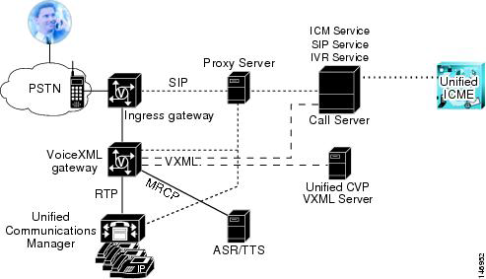
Cisco’s Solution for Contact Center

Slide 9
Components of Cisco’s Solution
Unified CVP Call Server
VXML Server
Cisco Unified Call Studio
Unified CVP Reporting Server
Unified CVP Operations Console Server
Additional Unified CVP Solution-Related Components
NON CVP
Cisco Ingress Voice Gateway
Cisco VoiceXML Gateway
DNS Server
Media Server
Cisco Unified Communications Manager
Cisco Unified Contact Center
SIP Proxy Server
•

Slide 10
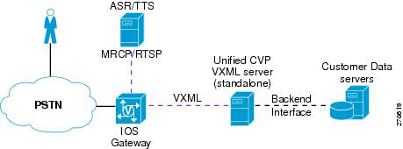
Standalone Solution

Slide 11
Step wise explanation
A call arrives at the ingress gateway via TDM, or SIP. The gateway performs normal inbound POTS or VoIP dial-peer matching
The selected VoiceXML gateway port invokes the Unified CVP self-service TCL script.
The TCL script invokes the Unified CVP standalone bootstrap VoiceXML Document, which performs an
HTTP request to the configured IP address of the Unified CVP VXML Server.
The Unified CVP VXML Service function is resident in the CVP Server. The Unified CVP VXML Service runs the application specified in the HTTP URL and returns a dynamically generated VoiceXML document to the VoiceXML gateway. The Unified CVP VXML Service may access back-end systems to incorporate personalized data into the VoiceXML document that is sent to the VoiceXML gateway.
The VoiceXML gateway parses and renders the VoiceXML document. For spoken output, the VoiceXML gateway either retrieves and plays back prerecorded audio files referenced in the VoiceXML document, or it streams media from a text-to-speech (TTS) server. Caller input can be captured either by DTMF detection on the Ingress Gateway or via DTMF/speech recognition on an ASR server.
As defined in the VoiceXML document, the VoiceXML gateway submits an HTTP request containing the results of the caller input to the Unified CVP VXML Server. The IVR dialog ends when either the caller hangs up, the application releases, or the application initiates a transfer.er. The Unified CVP VXML Server again runs the application specified in the HTTP URL and returns a dynamically generated VoiceXML document to the VoiceXML gateway. The dialog continues by repeating steps 5 and 6.

Slide 12
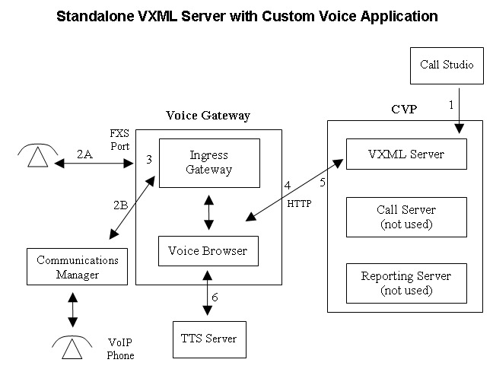

Slide 13
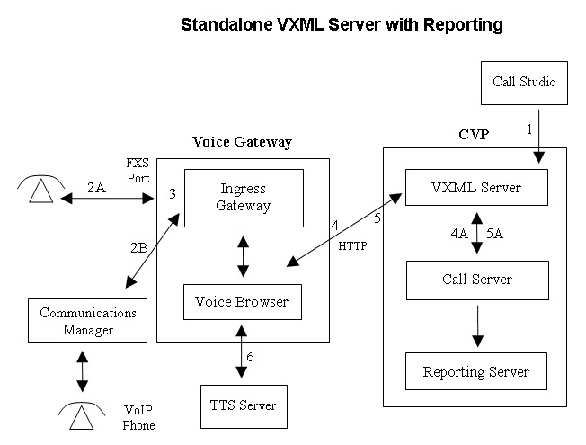

Slide 14
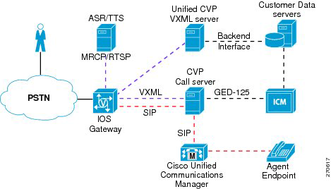
Comprehensive Solution

Slide 15
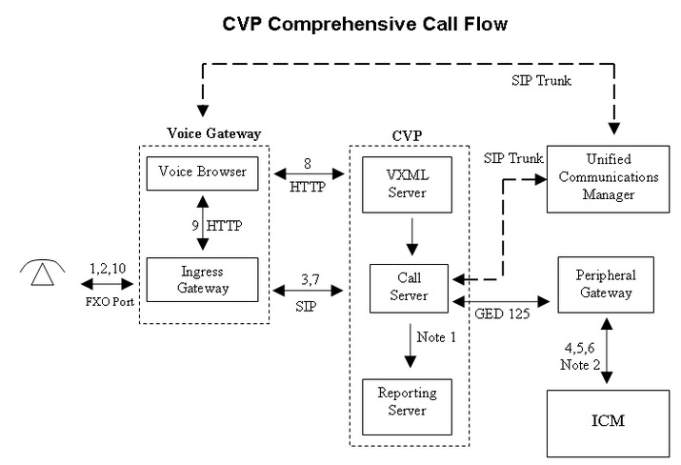

Slide 16
Initial Call Treatment and Self-Service
1 A call arrives at the ingress gateway and sends a SIP invite message to the SIP Proxy Server, which
forwards the request to the Unified CVP Server SIP Service.
2 The SIP Service sends a route request to Unified ICM via the Unified CVP Server ICM Service and the
VRU PG. This route request causes Cisco Unified ICM to run a routing script based upon the dialed
number and other criteria.
3 The Unified ICM routing script utilizes a Send to VRU node to return a label to the SIP Service and send a call to a VoiceXML gateway. The Unified CVP Server SIP Service sends an invite message to the VoiceXML gateway using the SIP Proxy Server, which translates the label DN to the IP address of the VoiceXML gateway.
4 The Voice XML gateway sends an HTTP new call message to the Unified CVP Server IVR Service with the label DN provided by Unified ICM. The IVR Service then sends a route request message to Unified ICM (using the Unified ICM Service), which then allows Unified ICM to re-enter the previously started routing script. The routing script is re-entered at the successful exit path of the Send to VRU node. The Unified ICM routing script uses Run Script nodes to instruct the IVR service about the desired call treatment. If call treatment requires complex IVR self-services, service control can be redirected to a Unified CVP VXML Server application. Upon completion of the Unified CVP VXML Server application or a request by the caller to transfer to a live agent, service control is returned to the Unified CVP Server IVR Service. If the initial call treatment is simple with just a few prompts, then the IVR Service can utilize Unified CVP microapplications to generate VoiceXML documents for the VoiceXML gateway, and a Unified CVP VXML Server is not required.

Slide 17
Caller Requests to Transfer to Live Agent
1 When the caller requests to transfer to a live agent, the Unified ICM routing script queues the caller for an appropriate skill group and sends Run VRU Script messages to the IVR Service to have queue treatment provided (assuming no agent is available).
2 When a Unified CCE agent becomes available, Unified ICM requests the Unified CVP Server IVR Service to transfer the call the to selected agent.
3 The IVR Service then requests the SIP Service to transfer the caller to the dialed number of the selected agent. The SIP Service sends a SIP invite message to the SIP Proxy Server, which finds the Unified CM SIP Trunk IP address associated with this agent DN, and then forwards the SIP Invite message to Unified CM.
4 Unified CM accepts the incoming SIP Trunk call and routes it to the selected agent.

Slide 18
Gateway Configuration
ip host tts-en-us <put IP of TTS server here>
ip host asr-en-us <put IP of ASR server here>
application
service helloworld flash:CVPSelfService.tcl
param CVPPrimaryVXMLServer <put CVP VXML Server IP here>
param CVPSelfService-port 7000
param CVPSelfService-app HelloWorld
dial-peer voice 8 voip
service helloworld
description receives POTS call for helloworld and changes to VoIP
destination-pattern 8002221111
session target ipv4:<put gateway IP here>
incoming called-number 8002221111
dtmf-relay rtp-nte h245-signal h245-alphanumeric
codec g711ulaw
no vad

Slide 19
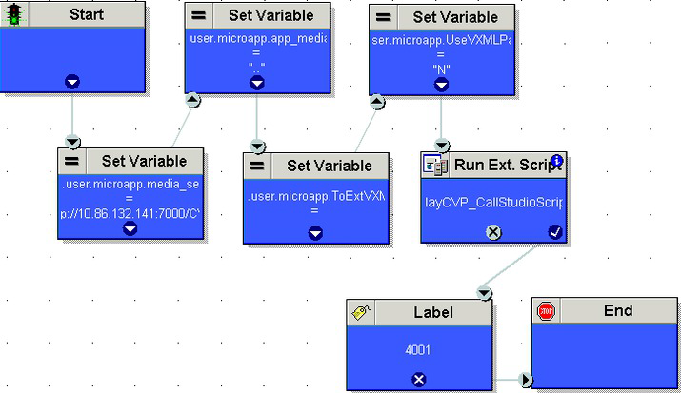
ICM Scripting

Slide 20
Questions?

Slide 21
IVR Overview
Prepared by:
Arthel Lynne Francisco
07/11/2015

Slide 22
What is Voice Portal?
Voice Portal
voice equivalent of Web Portals, giving access to information through spoken commands and voice responses.
may be referred to as Interactive Voice Response (IVR) systems, but this term also includes DTMF(dual-tone multi frequency) services.
Caller Interaction
- by voice (speech recognition)
- by telephone keypad interface (dual-tone multi frequency)
Enterprise Voice Portal
Provides customized access to customer support.
Manage inbound and outbound voice traffic and agent controls
Platforms: Cisco, Avaya

Slide 23
IVR Definitions
IVR (Interactive Voice Response) System
A technology that allows a computer to interact with humans through the use of voice and DTMF tones input via keypad.
allows customers to interact with a company’s host system via a telephone keypad or by speech recognition, after which they can service their own inquiries by following the IVR dialogue.
IVR systems can respond with prerecorded or dynamically generated audio to further direct users on how to proceed.
IVR applications can be used to control almost any function where the interface can be broken down into a series of simple interactions.
IVR systems deployed in the network are sized to handle large call volumes

Slide 24
High-Level Overview of Voice Portal

Slide 25
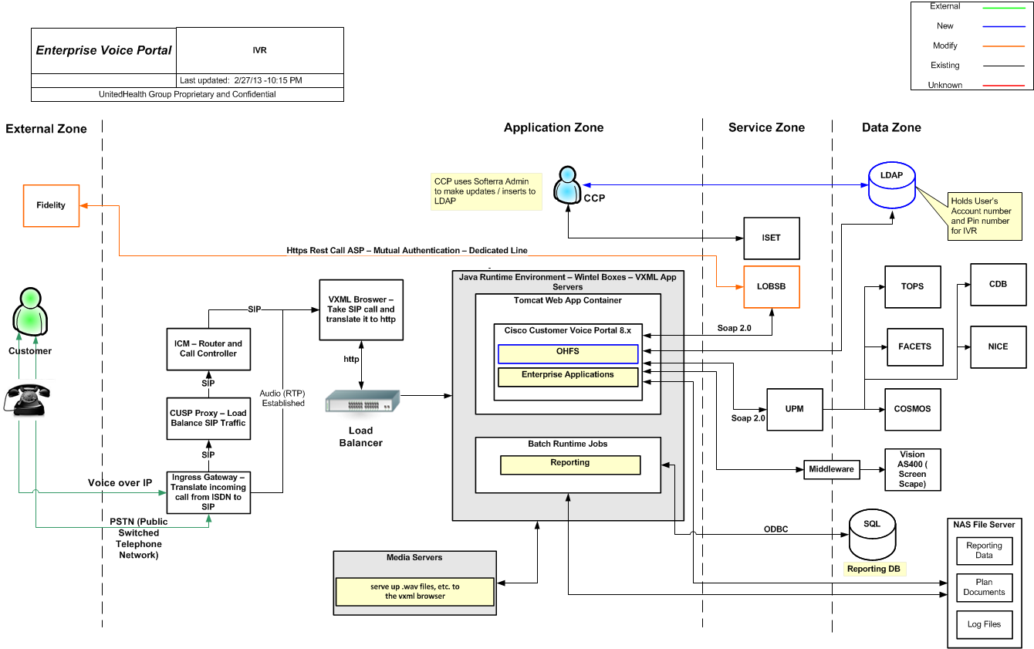
CCS Architecture

Slide 26
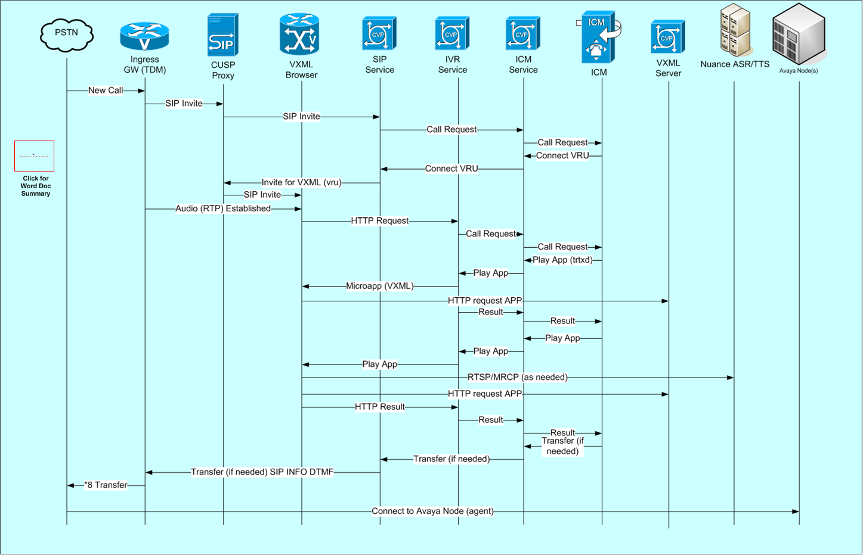
CallFlow

Slide 27
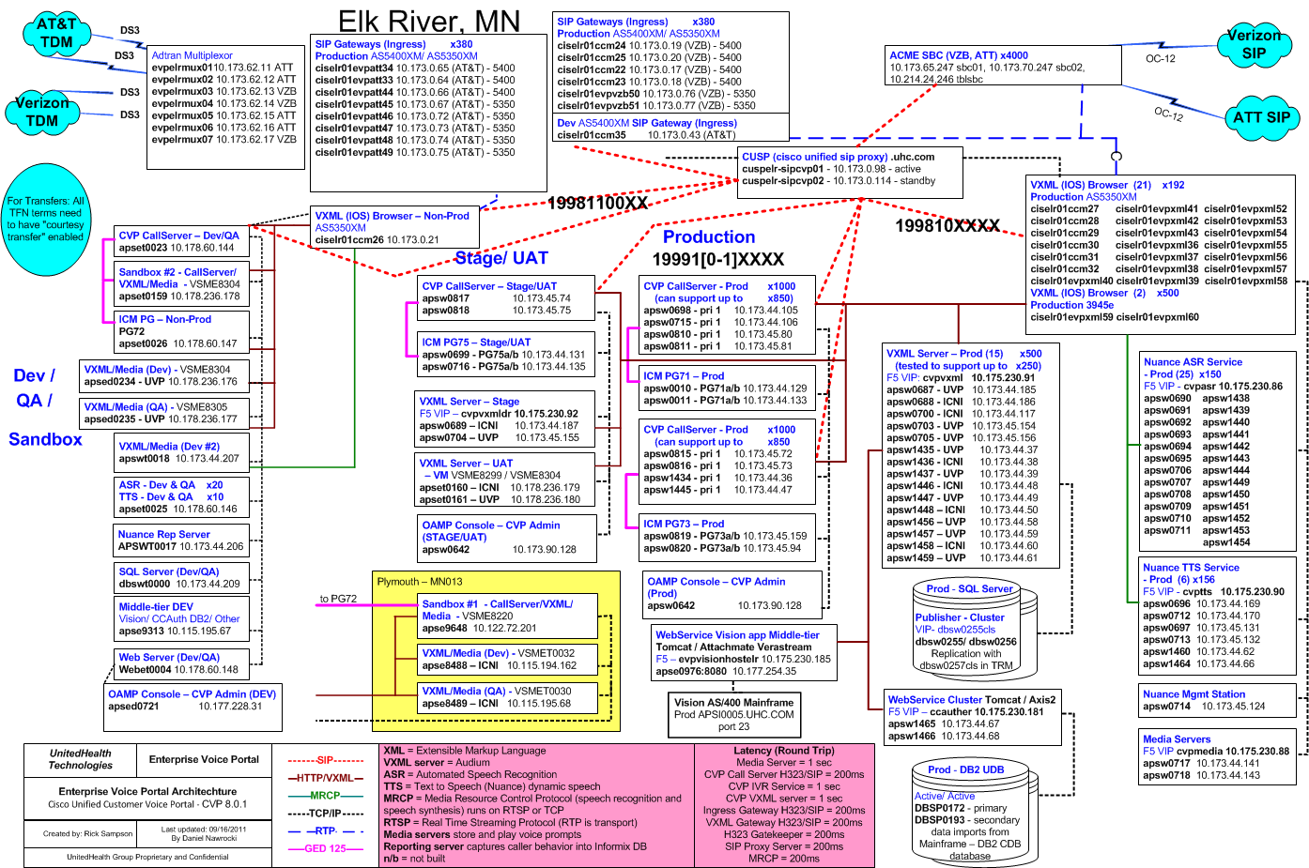
Elk River

Slide 28
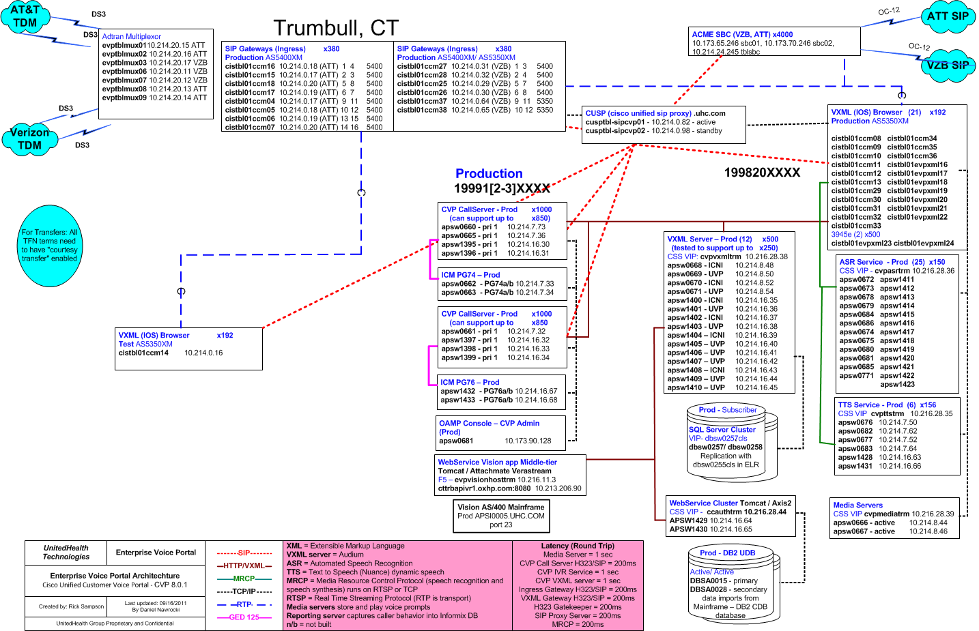
Trumbull

Slide 29
IVR Applications
iCNI Apps – apse8488/apse8489
UVP Apps - apsed0234/apsed0235
iCNI Cluster | ACNS | HARS | OHPS | RXMS
 | CASS | ICNC | OMNS | RXPS
 | DBNC | ISGS | OVAS | RXSS
 | DBPS | MAPS | OXBS | SAXC
 | DEVT | NHPS | OXMS | SICC
 | DPST | NLCC | OXPS | TRNC
 | EHCD | OBND | PSSS | UMRS
 | FRMS | OCNS | RIVS | UNIS
 | GLHS | OHFS | RREC | VISS
 | HAMT | OHMS | RXHS
UVP Cluster | CCDS | HAMT | PHPS | TRNC
 | CMDS | MEMS | PRVS | UIGS
 | COBS | PFCS | SICT

Slide 30
IVR Applications
Apps By Business:
UHC | CCDS Care Coordination | PFCS Pacificare CE and PE
 | CMDS Medica CE | PHD Medicare and Retirement Call Flow
 | COBS Coordination of Benefits | PHPS Harvard Pilgrim PE
 | CASS Community and State | PRVS Core PE
 | GLHS Great Lakes Health Plans | PSSS UMR for All Non-Harrington Providers
 | HARS Harrington Members and Providers | RIVS River Valley IVR
 | MAPS Ovations MAPD | RREC Rapid Response Expert Application
 | MEMS Core CE | TWBS TRICARE West Beneficiary
 | NHPS Neighborhood Health | TWPS TRICARE West Provider
 | OBND Easy Connect | UIGS Broker Employer
 | OVAS Ovations Part D | UMRS UMR for All Non-Harrington Members
 | Oxford OXMS/OXPS/OXBS | UNIS Unison IVR
Optum Health | ACNS ACN_PHS Self Service | OHFS Optum Health Financial Services
 | DBPS Dental including PDP | UBHC UBH CNI Application
 | FRMS Forms Hotline for UBH | UBHXQ UBH Public Sector Survey
 | OCNX On call nurse application | VISS Vision
 | OHBS Behavioral Solutions Claims, Benefits and Eligibility
Ovations | MAPS Ovations MAPD
 | OVAS Ovations Part D
Prescription Solutions | RXHS Prescription Solutions Pharmacy | RXSS Prescription Solutions Prior Auth
 | RXMS Prescription Solutions Mail Service | RXSS Authentication IVR

Slide 31
CCS Functional Areas
Project Management
Engaged on every project and work order
Sets and communicates initiative timelines and status
Coordinates work within the project team
Responsible for platform-wide prioritization and release scheduling
Planning and Analysis
Requirements definition and estimate coordination
System analysis
Process ownership
Product roadmaps
UI Design
Usability studies
Enterprise-level standardization/industry best practices
Evaluation of emerging UI methodology
Application tuning

Slide 32
CCS Functional Areas
Application Architecture
Cross-platform development standardization
Strategic development direction
Modularity/reusability
“How” to implement a solution
Quality Assurance
Functional application testing
Regression testing
Involved with every application change, no matter how small
Internal assessor of application quality
Application Data & Reporting
Report definition and execution
Statistics gathering
“How is an application performing?”

Slide 33
CCS Functional Areas
Call Delivery
Involved in every effort that impacts call routing, not only IVR work
Ensure calls are routed to the correct destination
Primary contact for Caller Needs Identification (iCNI)
Ownership of ICM and Routing Services
Application Support
IVR infrastructure ownership
Release Management
Day-to-day platform operations
Development
Turning a design into a usable application
Interaction with data providers
Application efficiency/overhead
Creating the end product

Slide 34
Overview of IVR Capabilities
Self-Service
Voice self-service offers many of the same features as web self-service
Allows callers to complete specific tasks through the phone system, both during and after business hours
Self-service is typically designed by population (Member, Provider, Broker, etc.) and/or by function (Medical, Pharmacy, Dental, etc.)
Intelligent Caller Needs Identification (iCNI)
Partial automation and call steering
iCNI attempts to route the caller appropriately by answering the following questions:
Who are you?
Why are you calling?
What is the most appropriate resource for your needs?
Members whose eligibility data is available in the Consumer Database (CDB) can be authenticated in iCNI, and their information passed to the agent desktop to reduce handle time.

Slide 35
Contact Center Services SDLC
Requirements Submission (Business)
System Analysis(SA)
Allocation of IT Resources
Design
Development
QA Testing
Regression Testing
User Acceptance Testing
Code Lockdown
Staging
Go Live

Slide 36
Types of Work
Projects
Any effort that requires a new IVR application
Any enhancement effort that requires involvement from a host/backend system
Any enhancement to an existing IVR application that is estimated to be greater than 160 hours of total work
Work Orders
Any enhancement to an existing IVR application that is estimated to be 160 hours of total work or less
All CNI (Caller Needs Identification) work (iCNI) – Call Delivery engagement
All IVR tuning
Testing-only support, for projects that primarily impact other portals but require regression testing/checkout from EVP
Certain specific IT needs (host/backend system upgrades, UPM versioning, etc.)

Slide 37
Questions?

Slide 38
Development Process
Prepared by:
Arthel Lynne Francisco
07/12/2015

Slide 39
Topics
Projects/Work Orders Workflow
Task Allocation
Work Intake
SA Document
VUI
Development Process

Slide 40
Process – Work Order/Project
Requirements Submission
(Business)
SA (System Analyst)
Allocation of IT Resources (Functional Managers)
Design (VUI)
Development
(IVR Dev)
Development (Web Services Dev)
Go Live
Staging (QA/UAT)
Code Lockdown (Release Manager)
UAT
Regression Testing (QA)
QA Testing (QA)

Slide 41
Process – Work Order/Project
Release Management
scheduled to be performed every six weeks, except for “special” releases
July 2015 Release Schedule:
Requirements Submission Deadline 5/21
SA 5/22 – 6/3 (accounted for U.S. Holiday – Memorial Day)
Allocation of IT resources: 6/4 – 6/8
Design 6/9 – 6/16
Development 6/17– 6/23
QA 6/24 – 7/3 (accounted for U.S. Holiday - Independence Day)
Regression Readiness Testing 7/6 – 7/8
UAT 7/9 – 7/17 (accounted for Ramadan Holiday)
Code Lockdown 7/20
Staging 7/28
Go Live 7/30
Other Release Opportunities in between scheduled releases:
Staging: 8/11
Go Live: 8/13
Staging 8/25
Go Live: 8/27

Slide 42
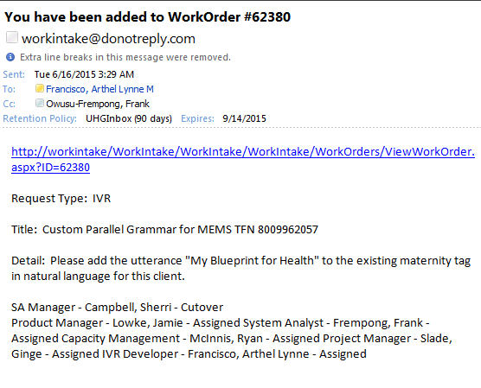
Task Allocation

Slide 43
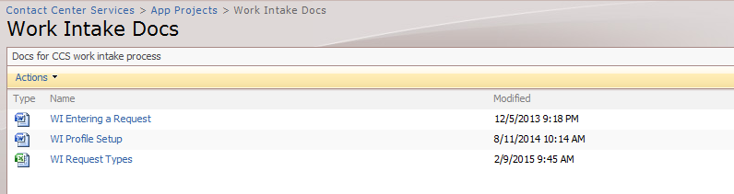
Task Allocation – Work Intake
Work Intake: https://workintake/WorkIntake/WorkIntake/
View Assigned Work Orders
Search Work Orders
Status of Work Orders
Resources assigned to the WO/Project
Documents needed for the WO/Project
Work Intake New Users Guide:
https://workintake/WorkIntake/WorkIntake/CommonAccess/Help/Help.aspx
WI Profile Setup:
http://it-ics.uhc.com/sites/CCS/VPProjects/Work%20Intake%20Docs/Forms/AllItems.aspx

Slide 44
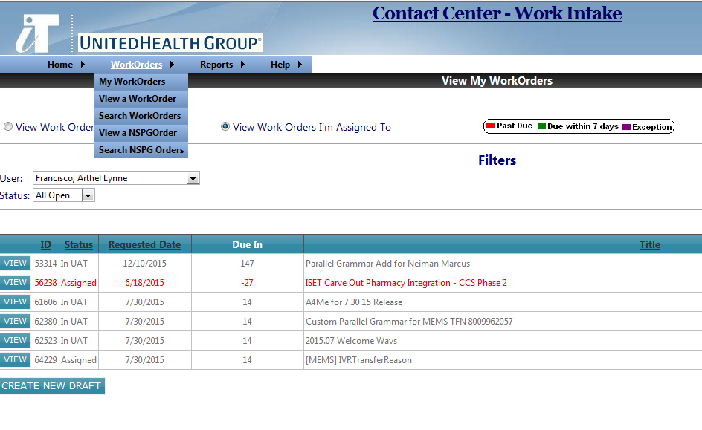
Work Intake – My WorkOrders

Slide 45
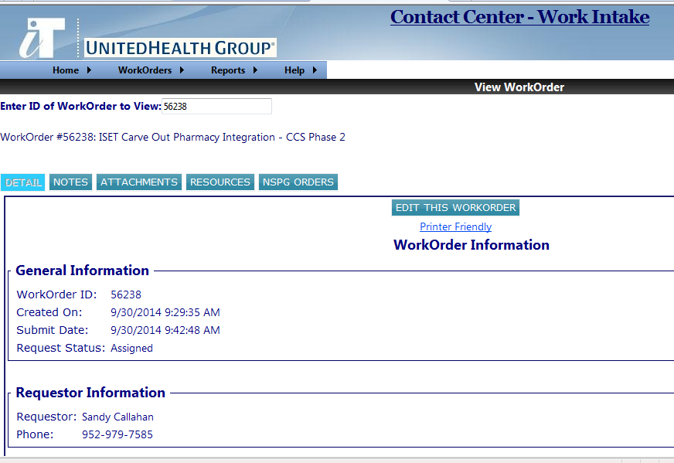
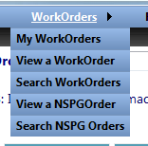
Work Intake – View Work Order

Slide 46
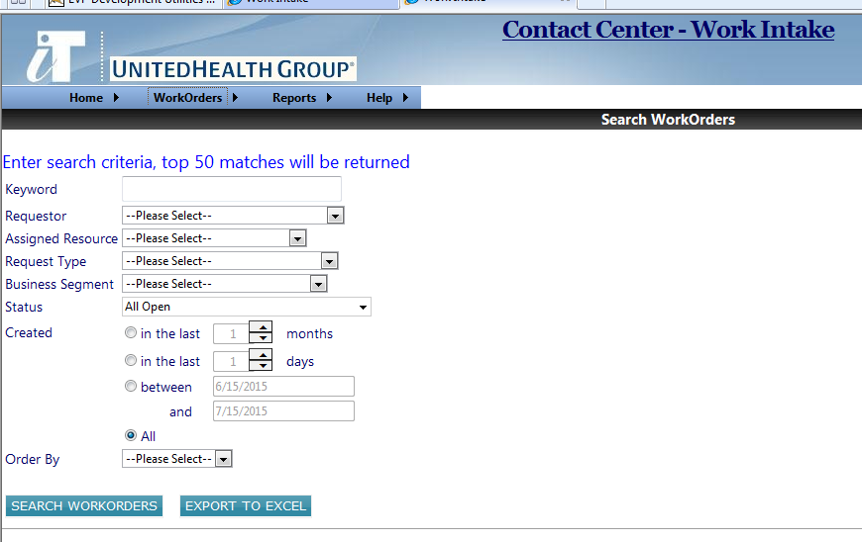
Work Intake – Search Work Order

Slide 47
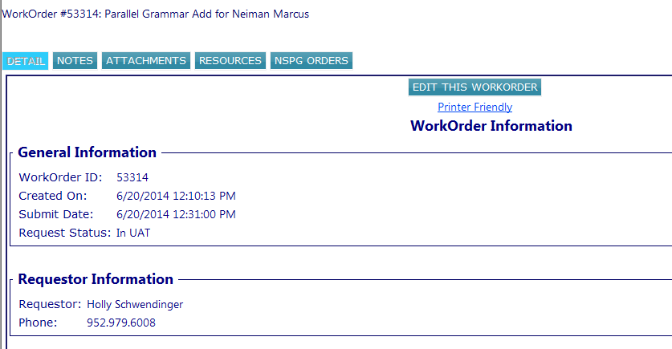
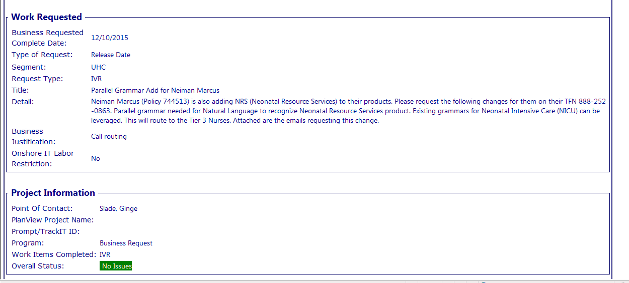
Work Intake –Work Order(Details)

Slide 48
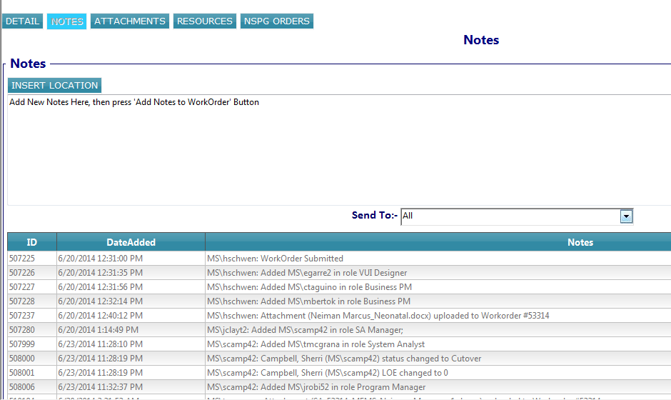
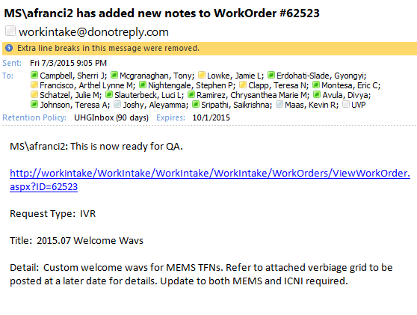
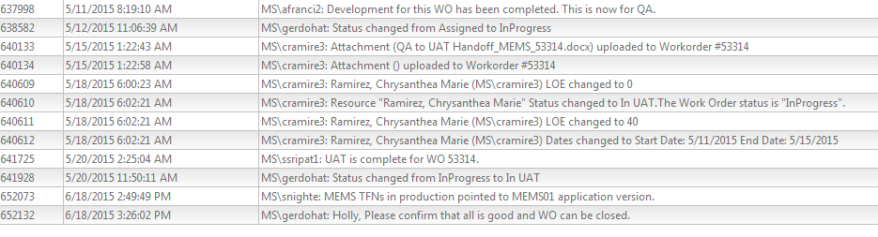
Work Intake –Work Order(Notes)

Slide 49
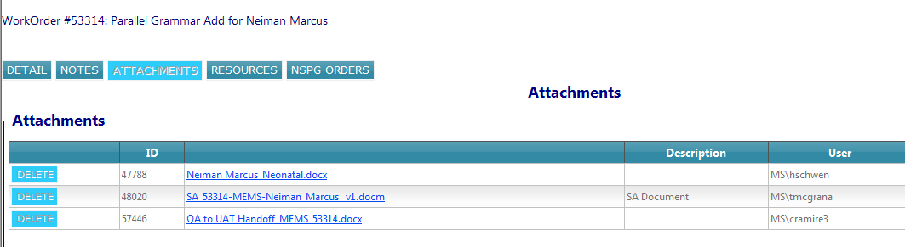
Work Intake –Work Order(Attachments)

Slide 50
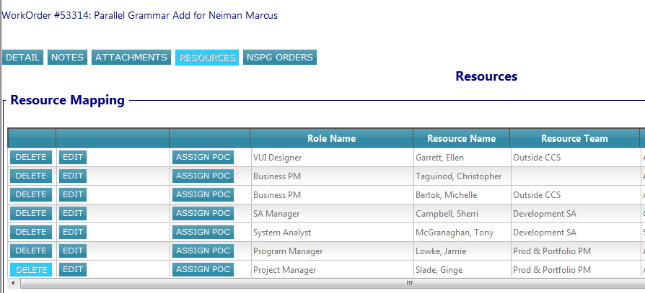
Work Intake –Work Order(Resources)

Slide 51
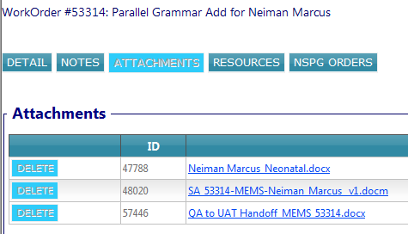
SA Document
Attached in the Work Intake
System Analysis Requirements
Work Intake Requiremets
Requestor
Prepared By
LOE
Impacted Application(s)
Business Requirements Summary
Current Process
Proposed Process
Technical Specifications
Development Scope
TFNs
Wav Files
Grammars
IVR Development
QA scope
Enterprise Call Delivery(ECD)/Experience Manager/LIGHTSpeed/VCCD

Slide 52
VUI (Voice User Interface)
VUI Links: http://apse8489.uhc.com:5050/DevUtil/application_vuis.jsp
Sharepoint Link: http://it-ics.uhc.com/sites/CCS/VPProjects/UHC/Forms/AllItems.aspx?RootFolder=%2fsites%2fCCS%2fVPProjects%2fUHC%2fIVR%2fProduction%20Applications&FolderCTID=0x01200055BC5C93320C85409FAB35B21B0D1367&View=%7b96DC053F%2d4EEA%2d46E3%2dB787%2d4057F282283B%7d
Call flow changes

Slide 53
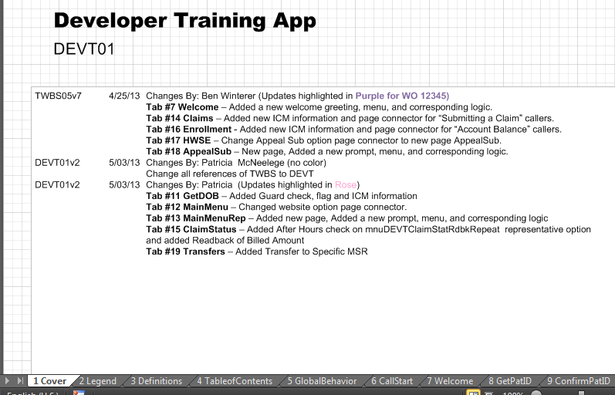
VUI – Cover Page
What WO is the change for?
What are the affected tabs?
Application Version

Slide 54
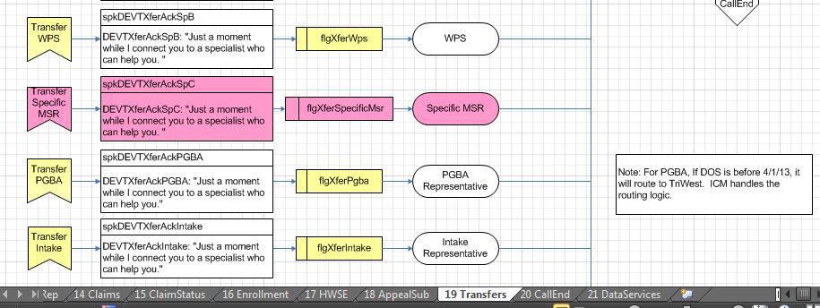
VUI – Call flow Changes

Slide 55
Development Process
Handoff to Dev
TFN Setup (ICM)
Handoff to QA
Development
PDB Setup (ICM) – if needed
Defect Resolution (if applicable)
Unit Test

Slide 56
Questions?

Slide 57
Development Process
Prepared by:
Arthel Lynne Francisco
07/12/2015

Slide 58
Topics
Project List
Cisco Unified Call Studio
Call flows
Wav files
Grammar Files
Application Checkout/Commit Workflow
DEV/QA Deployment
Unit Testing
Daily Status Report
Defect Resolution Process
Wav File Swaps

Slide 59
Project List/Release Tracking Document
List of all Tasks
Task ID
Description
Resources Assigned to WO/Project
Business Unit/Business Priority
Type (Work Order/Project)
App Name
Scope
Sharepoint Link:
http://it-ics.uhc.com/sites/CCS/VPProjects/Shared%20Documents/Forms/AllItems.aspx?RootFolder=http%3a%2f%2fit%2dics%2euhc%2ecom%2fsites%2fCCS%2fVPProjects%2fShared%20Documents%2fProject%20Status%20List&FolderCTID=0x0120006DCC5A6D9D1D274AAF63BB20455421E3
Sharepoint Link:
http://it-ics.uhc.com/sites/CCS/VPProjects/Shared%20Documents/Forms/AllItems.aspx?RootFolder=http%3a%2f%2fit%2dics%2euhc%2ecom%2fsites%2fCCS%2fVPProjects%2fShared%20Documents%2fProject%20Status%20List&FolderCTID=0x0120006DCC5A6D9D1D274AAF63BB20455421E3
Type | Scope | Abbrev | SA | VUI | Dev | QA | Total
Work Order | Small | W - Small | 15 | 4 | 40 | 30 | 89
 | Medium | W - Medium | 30 | 14 | 60 | 45 | 149
 | Large | W - Large | 50 | 20 | 80 | 83 | 233
Project | Small | P - Small | 60 | 26 | 300 | 240 | 626
 | Medium | P - Medium | 80 | 100 | 600 | 450 | 1230
 | Large | P - Large | 160 | 210 | 900 | 675 | 1945
 | XLarge | P - XLarge | 320 | 450 | 2500 | 1875 | 5145
OM Ticket |  | O | 5 | 1 | 3 | 12 | 21
IT Need |  | I | 10 | 0 | 40 | 30 | 80
Analysis Only |  | A | 60 | 10 | 4 | 0 | 74
Test Only |  | T | 40 | 5 | 40 | 240 | 325
Wav File Swap |  | WF | 5 | 2 | 2 | 0 | 9

Slide 60
Cisco Unified Call Studio
an integrated development environment (IDE) for voice self-service applications which allows you to build sophisticated speech-enabled telephone self-service.
takes advantage of new enhancements and improvements provided with Eclipse
An intuitive drag-and-drop environment, built on Eclipse

Slide 61
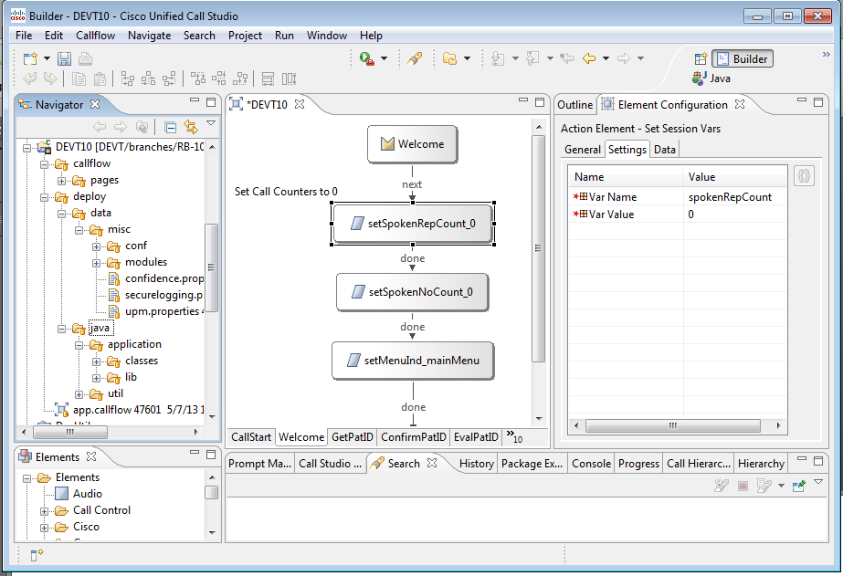
Cisco Unified Call Studio
Callflow
Element Configuration
Callflow tabs and elements
Configuration files
Custom Elements/Class files/Libraries
Application’s Callflow
Voice Elements/
Custom Elements

Slide 62
VUI Call flow vs Call Studio Call Flow

Slide 63
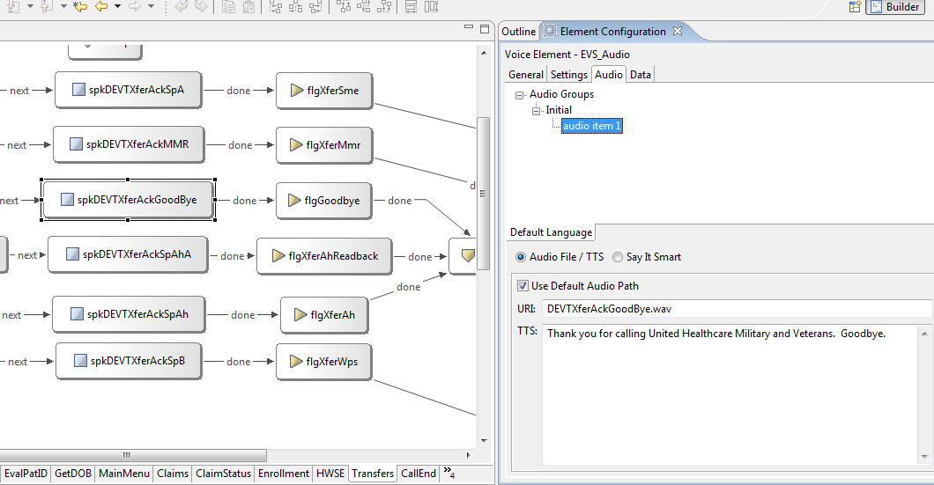
Audio Prompts
Audio Element

Slide 64
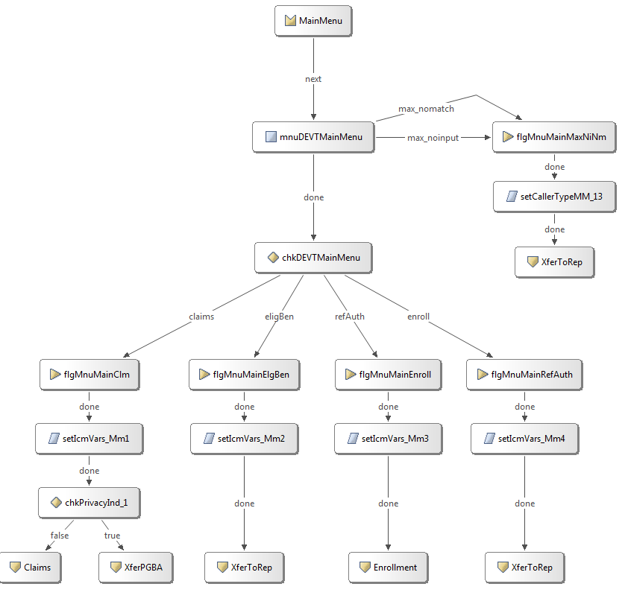
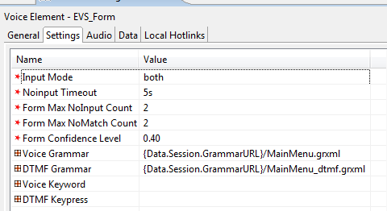
Audio Prompts
Audio Form Element
Input Mode: Voice/DTMF/Both
Max Tries that the IVR can handle Caller Input
Grammar Files used

Slide 65
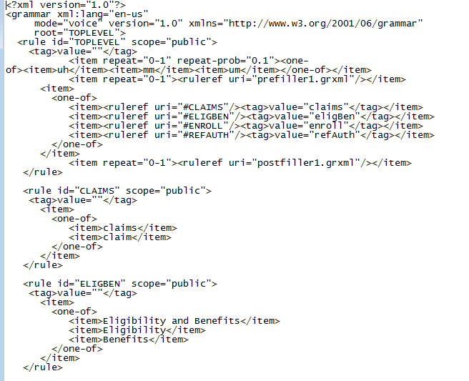
Grammar Files – Voice
Tag Value → Value returned in MainMenu prompt
Utterances recognized by IVR
Location: http://svn.uhc.com/svn/uht_cca_cvp/<App>/branches/RB-##.x/Grammars

Slide 66
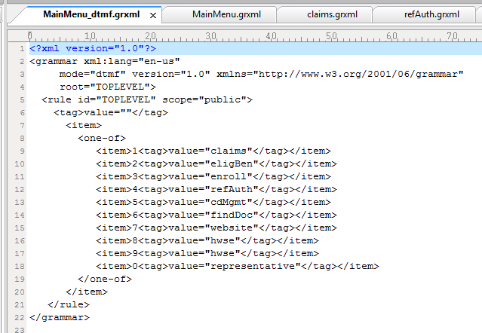
Grammar Files - DTMF
DTMF Inputs – Value

Slide 67
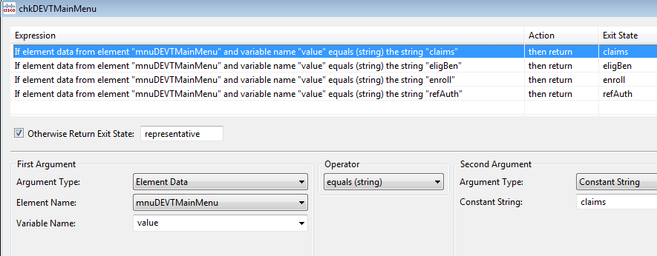
Grammar Files
Value: claims

Slide 68
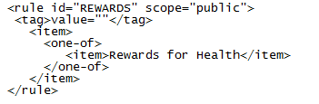
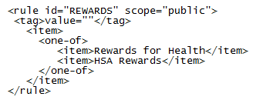
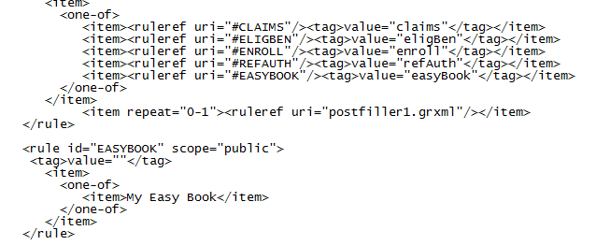
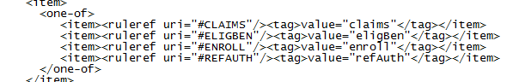
Grammar Files
Types of Work
Adding Utterance to existing grammar file
Business requirement: Add the utterance “HSA Rewards" to the existing rewards tag
Adding new tag/menu
Creating new grammar files

Slide 69
Wav Files and Supporting Codes
Wav Files
Prompts
Welcome Greetings
Location: http://svn.uhc.com/svn/uht_cca_cvp/<App>/branches/RB-##.x/WAVs
Types of Work:
Updating wav files for specific prompts
Adding new wav files for new prompts
Adding/Deleting welcome greetings
Wav file Swaps
Common/Supporting Codes
http://svn.uhc.com/svn/ut_uvp/code_uvp/branches/RB-##.1.x
http://svn.uhc.com/svn/uht_cca_cvp/DevCode/trunk

Slide 70
Application Checkout/Commit Workflow
Check Production Version of Application
Checkout Media to Staging Folder
Setup Anthill for new version (auto build function)
Checkout application from SVN Repository
Copy New Version of Application using Deployment Helper
Apply the Changes in Call Studio /Wav Files /Grammar Files
Commit changes made in Call Studio
Wait for Build Notification Email

Slide 71
Check Current Production Version of Application
Cluster 1 http://apsep3695:7000/CVP/reports/page.txt
Cluster 2 http://apsep3700:7000/CVP/reports/page.txt
Cluster 3 http://apsep3703:7000/CVP/reports/page.txt
Apps per Cluster
Cluster 1 | ACNS | HARS | OHPS | RXMS
 | ATTC | ICNC | OVAS | RXMS
 | CASS | ISGS | OXBS | RXPS
 | CLOST | MAPS | OXMS | RXSS
 | DBNC | NHPS | OXPS | SAXC
 | DBPS | NLCC | PSSS | TRNC
 | DNCC | OBND | RIVS | TRTD
 | EHCD | OCNS | RREC | UMRS
 | FRMS | OHFS | RXHS | UNIS
 | GLHS | OHMS | RXMC | VISS
Cluster 2 | CMDS | MEMS | PFCS
 | COBS | PFCS | PHPS
 | EHCD | PFCS | UIGS
Cluster 3 | CCDS | EHCD | PRVS

Slide 72
Check Current Production Version of Application
Application Versioning
Skip 1 Version
Example:
Current Production Version: MEMS01
Version for the Next Release: MEMS03

Slide 73
Application Checkout/Commit Workflow
Check Production Version of Application
Checkout Media to Staging Folder
Setup Anthill for new version (auto build function)
Checkout application from SVN Repository
Copy New Version of Application using Deployment Helper
Apply the Changes in Call Studio /Wav Files /Grammar Files
Commit changes made in Call Studio
Wait for Build Notification Email

Slide 74
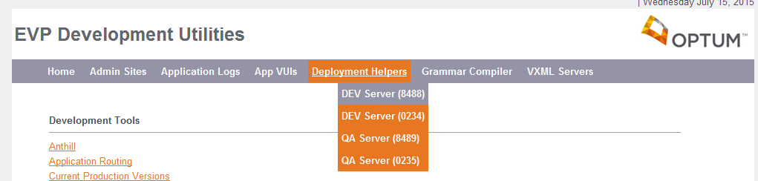
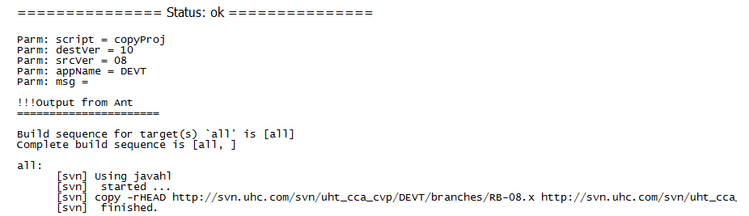
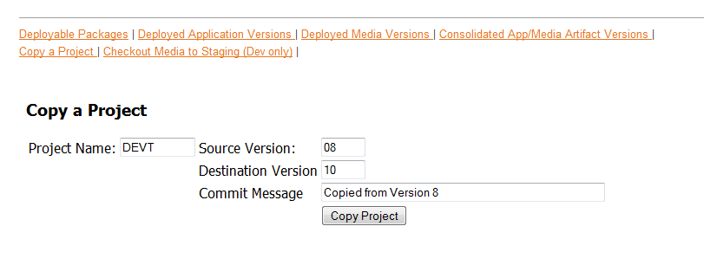
Copy new Version of Application
Using EVP Deployment Helper(Server:apse8488)
Application Name (4-5 letters)
Current Version in Production
New Version Number

Slide 75
Application Checkout/Commit Workflow
Check Production Version of Application
Checkout Media to Staging Folder
Setup Anthill for new version (auto build function)
Checkout application from SVN Repository
Copy New Version of Application using Deployment Helper
Apply the Changes in Call Studio /Wav Files /Grammar Files
Commit changes made in Call Studio
Wait for Build Notification Email

Slide 76
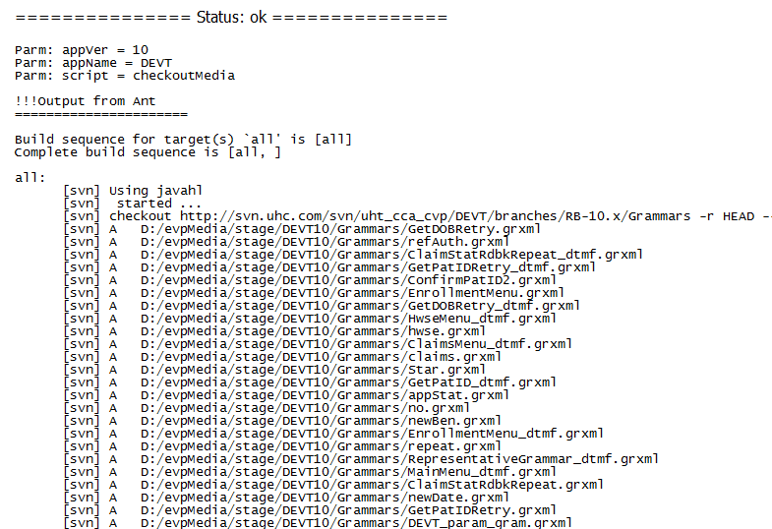
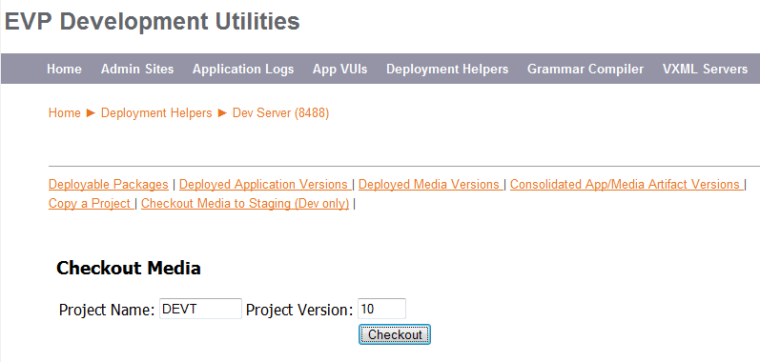
Checkout Media to Staging Folder
Application Name (4-5 letters)
New Version Number

Slide 77
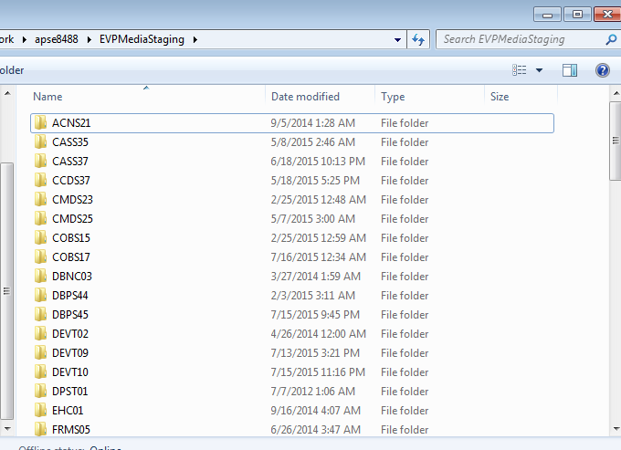
EVP Media Staging Folder
Staging Folder: \\apse8488\EVPMediaStaging
http://svn.uhc.com/svn/uht_cca_cvp/<APPNAME>/branches/RB-<APPVERSION>.x/Grammars
http://svn.uhc.com/svn/uht_cca_cvp/<APPNAME>/branches/RB-<APPVERSION>.x/WAVs

Slide 78
Application Checkout/Commit Workflow
Check Production Version of Application
Checkout Media to Staging Folder
Setup Anthill for new version (auto build function)
Checkout application from SVN Repository
Copy New Version of Application using Deployment Helper
Apply the Changes in Call Studio /Wav Files /Grammar Files
Commit changes made in Call Studio
Wait for Build Notification Email

Slide 79
Setup Anthill for new version (auto build function)
Copy a Project in Anthill for Automatic Build function
Link: http://ahp.uhc.com/
Modify Project Settings in Anthill
Open Anthill
Click Administration tab
Go to UHGIT folder
Click EVP
Select app to be copied
Copy latest Work flow
Edit properties of the copied Work Flow
Change Build Name to appropriate version and save
Update Source Configuration to proper version and save
Change the build version and save
Update value of the projcode on the properties tab

Slide 80
Application Checkout/Commit Workflow
Check Production Version of Application
Checkout Media to Staging Folder
Setup Anthill for new version (auto build function)
Checkout application from SVN Repository
Copy New Version of Application using Deployment Helper
Apply the Changes in Call Studio /Wav Files /Grammar Files
Commit changes made in Call Studio
Wait for Build Notification Email

Slide 81
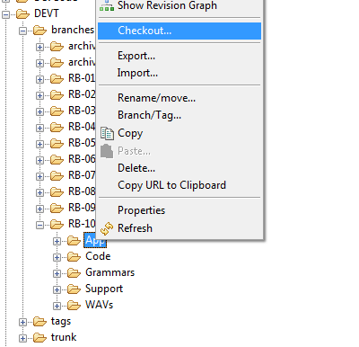
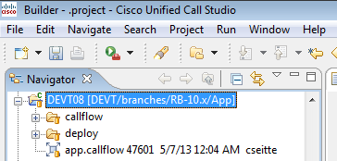
Checkout application from SVN Repository
SVN Repository: http://svn.uhc.com/svn/uht_cca_cvp

Slide 82
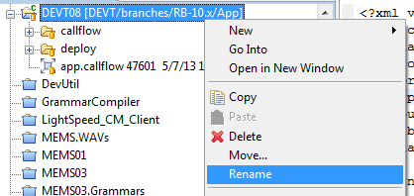
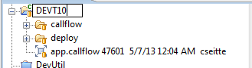
Checkout application from SVN Repository
Update Application Name

Slide 83
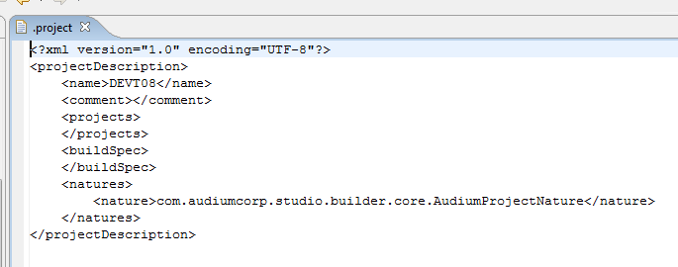
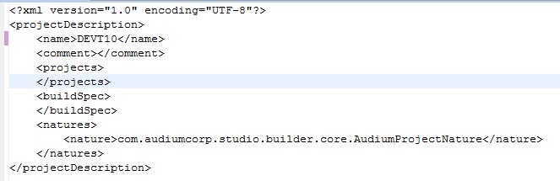
Checkout application from SVN Repository
Update Current Version Number in the .project file

Slide 84
Application Checkout/Commit Workflow
Check Production Version of Application
Checkout Media to Staging Folder
Setup Anthill for new version (auto build function)
Checkout application from SVN Repository
Copy New Version of Application using Deployment Helper
Apply the Changes in Call Studio /Wav Files /Grammar Files
Commit changes made in Call Studio
Wait for Build Notification Email

Slide 85
Apply the Changes(Call Studio/Wav Files/Grammar Files)
Callflow Changes
Apply the changes required by the WO/Project in CISCO Call Studio
Update the application to make sure that the project is up-to-date.
Right click application >> Team >> Update to Head
Validate the application to check for errors
Right Click application >> Validate
Wav Files/Grammar Files Updates
Copy to EVP Media Staging Folder

Slide 86
Application Checkout/Commit Workflow
Check Production Version of Application
Checkout Media to Staging Folder
Setup Anthill for new version (auto build function)
Checkout application from SVN Repository
Copy New Version of Application using Deployment Helper
Apply the Changes in Call Studio /Wav Files /Grammar Files
Commit changes made in Call Studio
Wait for Build Notification Email

Slide 87
Commit Changes (Call Studio/Media Staging Folder)
Callflow Changes
Commit the changes in the application
Commits to the SVN repository will trigger the Anthill’s auto-build
Comment Convention :
Work Orders: WO #####: <comment-text>
Projects: 4-#####: <comment-text>
PM Tickets: PM########: <comments-text>
Catch All: EVP: <project> - <comments-text>
Wav Files/Grammar Files Updates
Copy the wav files/grammar files in EVP Media Staging Folder
NOTE: Every 10 minutes, a scheduled job goes through all applications on the server and checks for any updates made to the repository for both the wav files and grammars. If it detects updates, then it will commit the files automatically for each application.

Slide 88
Application Checkout/Commit Workflow
Check Production Version of Application
Checkout Media to Staging Folder
Setup Anthill for new version (auto build function)
Checkout application from SVN Repository
Copy New Version of Application using Deployment Helper
Apply the Changes in Call Studio /Wav Files /Grammar Files
Commit changes made in Call Studio
Wait for Build Notification Email

Slide 89

Build Notification Email
Application Name
Application Version
Build Version
Status: Success/Failed
Changelog

Slide 90
Dev/QA Deployment
Deploy Application and Media in Dev and QA (UVP/ICNI)
Push the application using the Admin Sites
Ask the ICM to point the TFNs to the specific application and version
Ready for Testing

Slide 91
Dev/QA Deployment Sites
UVP(Unified Voice Portal) Apps
DEV: http://apsed0234.uhc.com:5050/EvpDeploy/
QA: http://apsed0235.uhc.com:5050/EvpDeploy/
iCNI (Intelligent Caller Needs Identification )Apps
DEV: http://apse8488.uhc.com:5050/EvpDeploy/
QA: http://apse8489.uhc.com:5050/EvpDeploy/

Slide 92


Deployment Helpers
Using the deployment helper , check the Media and App you want to deploy then click Submit

Slide 93
Dev/QA Deployment
Deploy Application and Media in Dev and QA (UVP/ICNI)
Push the application using the Admin Sites
Ask the ICM to point the TFNs to the specific application and version
Ready for Testing

Slide 94
Admin Sites
UVP(Unified Voice Portal) Apps
DEV: http://apsed8488:5050/CVPAdminClient/admin.html
QA: http://apsed8488:5050/CVPAdminClient/admin.html
iCNI (Intelligent Caller Needs Identification )Apps
DEV: http://apsed0234:5050/CVPAdminClient/admin.html
QA: http://apsed0235:5050/CVPAdminClient/admin.html

Slide 95


Admin Sites
Run Deploy / Update Application Script using Admin Sites
New App (Deploy App Script)
Existing App (Update App Script)

Slide 96

VXML Server Startup
Server Start-Up:
http://apsed0235:5050/ServerRestart/

Slide 97
Dev/QA Deployment
Deploy Application and Media in Dev and QA (UVP/ICNI)
Push the application using the Admin Sites
Ask the ICM to point the TFNs to the specific application and version
Ready for Testing

Slide 98

Point TFN to App Version
Ask ICM Analyst to point the TFNs needed to working version.
By Email/ Add a note in Work Intake
Sample Email:

Slide 99
Dev/QA Deployment
Deploy Application and Media in Dev and QA (UVP/ICNI)
Push the application using the Admin Sites
Ask the ICM to point the TFNs to the specific application and version
Ready for Testing

Slide 100
Unit Testing
Testing Steps
Dial appropriate Simulator Number
Simulator Numbers:
DEV – 866 460 8855
QA – 866 460 8857
Enter TFN(Toll Free Number) for Application
Input the 10 digit TFN for your application.
Enter ANI
You can enter specific ANI or just press the # sign for default
Activity Logs/Call Logs
DEV Activity Log URL for UVP Cluster
\\apsed0234\c$\Cisco\CVP\VXMLServer\applications
QA Activity Log URL for UVP Cluster
\\apsed0235\c$\Cisco\CVP\VXMLServer\applications
DEV Activity Log URL for ICNI Cluster
\\apse8488\c$\Cisco\CVP\VXMLServer\applications\
QA Activity Log URL for ICNI Cluster
\\apse8489\c$\Cisco\CVP\VXMLServer\applications

Slide 101
Unit Testing
ICM Variables:
SetECCVarsOnExit
Filter ICM Variables
Unit Test Plan Template
Work Order Number
Application Version
Description of the WO
VUI version used and latest SA document version
Test Data/Test Tool used
Tabs Subjected to Change
Functionality and Menus to test

Slide 102
Daily Status Reports
Send a report at the end of each day
Start: VUI Handoff/Dev Start
End: QA Handoff
Send to resources assigned in Work Intake
PM, SA, VUI, QA, UAT, ICM, etc.
At 100% (QA Handoff), add the build numbers for App and Media
Template:

Slide 103
Dev Defect Resolution Process
UAT/QA finds a defect
UAT/QA assigns the defect to the developer
Developer – Assess the defect
Update application(s) to fix the defect
Commit the code into Subversion, SVN description must include the Workorder Number and the Defect Number
Unit/System test the defect
Assign defect back to QA
QA/UAT tests the defect and closes on complete

Slide 104
Wav File Swap
What is Wav file Swap?
synching a wav file (or grammar!) into production outside of a standard EVP deployment window.
This process begins when the UHG IT VUI designer provides the wav file to the assigned developer.

Slide 105

Wav File Swap Process
Load files to appropriate folder in staging: \\apse8488\evpmediastaging
Wait for the Anthill to build the application
Once alerted, deploy the media files on Dev and QA
Create a folder in a special share drive so that Ron Oliver can pull the file from here for the synch \\apse8489\d$\Media_Updates
Alert Ron Oliver and appropriate PM/SA that files have been loaded to all necessary folders
Reference Document

Slide 106
EVP Development Utilities
Location: http://apse8489.uhc.com:5050/DevUtil/
Common Links and Tools
Deployment Helpers
Admin Sites
Application Logs
App VUIs
Grammar Compiler
VXML Server Restart

Slide 107
References
Voice Portal Application Development Process
EVP Utilities
Development Docs
http://it-ics.uhc.com/sites/CCS/VPProjects/CCAS%20Documents/Forms/AllItems.aspx?RootFolder=%2fsites%2fCCS%2fVPProjects%2fCCAS%20Documents%2fEVP%20Developer%20Resources&FolderCTID=&View=%7bB912CF78%2d37B2%2d459A%2d8A99%2dB8FD840CCE6C%7d
CCS Docs
http://it-ics.uhc.com/sites/CCS/VPProjects/CCAS%20Documents/Forms/AllItems.aspx?View=%7bB912CF78%2d37B2%2d459A%2d8A99%2dB8FD840CCE6C%7d

Slide 108
Questions?

Slide 109
Creating New EVP project in Ant Hill Pro & SVN
Prepared by:
Surya & Munisekhar

Slide 110
SVN
Go to SVN repository http://svn.uhc.com/svn/uht_cca_cvp/ from tortoise SVN.
From Repo Browser right click and click “Create Folder”

Slide 111

Enter Project name we create and click ok

Slide 112

Once we click ok SVN will ask for comments. Enter the comments in appropriate format and click ok.

Slide 113

Similarly create other 3 folders with in project folder as below.

Slide 114

Under branches folder we will have all the code base with different versions for each release. Each branch name will follow the below format. Branches are generally incremented by 2. So the next branch will be RB-03.x.

Slide 115

Under each branch we will be having the below 4 folders. App folder will have the IVR code, Code will have the java code, Grammars will have grammar files and WAVs will have the media/audio files that will be used in IVR.

Slide 116

To add the code from our local to SVN under APP, right click in repo browser and select Add Folder and select the folder from file system that we need to add.

Slide 117

Tags folder will be used by ANT HILL to create a version for each build.

Slide 118
Ant hill pro
Go to http://ahp.uhc.com
Click on administration tab
Under UHGIT-> EVP

Slide 119

Below is the list of projects that are available under EVP folder.

Slide 120

Click on Copy Project on any project and click on EVP folder. Confirm to copy and a new project will be created with same name appended with Copy

Slide 121

Select the created project and click edit to set the name and other details.

Slide 122

Edit the name, description and click save.

Slide 123

Since this is a existing project we deactivate the older workflows and create a new one. Click on deactivate button on the right of workflow

Slide 124

Click ok to deactivate workflow.

Slide 125

Click on edit workflow to edit the properties like name as below format Build RB-01.X

Slide 126

Click on edit source and provide the SVN URL from where the source need to be built until the branch folder & tags. Click done

Slide 127

Click on stamping strategies and change the stamp value to match the version.

Slide 128

Go to Properties tab and change the project name to match the one with your application

Slide 129

Create a cluster property for deployment purposes. Based on cluster the application code environment will be set for deployment. UVP(0234/35) and ICNI(8848/89)

Slide 130
Questions?

